Slide 1
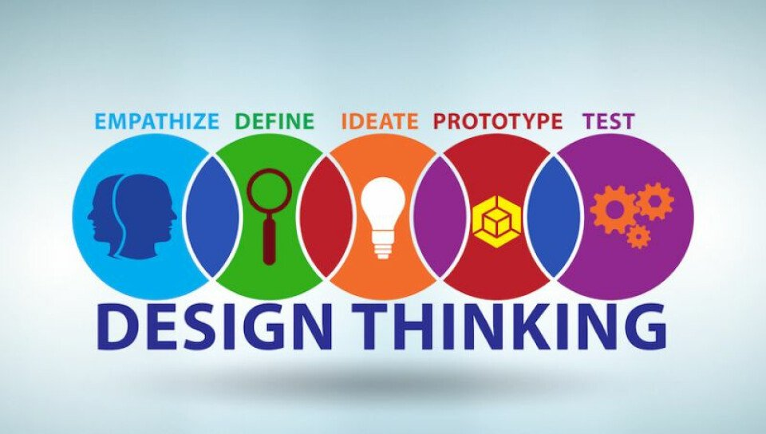
U20ITT615 – Design Thinking III Year / VI Semester

Slide 2
Course Outcomes
CO1 - Explain the fundamentals of Design Thinking and innovation. (K2)
CO2 - Empathize and analyze model action plan. (K2)
CO3 - Describe the principles of innovation and idea generation for product design. (K2)
CO4 - Apply design thinking techniques for given tasks. (K3)
CO5 - Apply the design thinking techniques for solving problems in various sectors. (K3)

Slide 3
Syllabus
UNIT I INTRODUCTION TO DESIGN
Introduction to elements and principles of Design, basics of design-dot, line, shape, form as fundamental design components. Principles of design - Introduction to design thinking - history of Design Thinking - New materials in Industry.
UNIT II- DESIGN THINKING
Design thinking process (empathize, analyze, idea & prototype), implementing the process in driving inventions, design thinking in social innovations. Tools of design thinking - person, costumer, journey map, brain storming, product development.
UNIT III- INNOVATION AND PRODUCT DESIGN
Art of innovation, Difference between innovation and creativity, role of creativity and innovation in organizations. Creativity to Innovation. Teams for innovation, Measuring the impact and value of creativity. Problem formation, introduction to product design, Product strategies, Product value, Product planning, product specifications
UNIT IV – DESIGN THINKING FOR STRATEGIC INNOVATION
An exercise in design thinking – implementing design thinking for better process. Implement design thinking process in various Industries. Design thinking for Startups.
UNIT V – DESIGN THINKING IN VARIOUS SECTORS
Case studies in Information Technology, Finance, Education, Management and Retail sector. Analyze and Prototyping, Usability testing, Organizing and interpreting results

Slide 4
Text Books and References
Text Books:
Change by design, Tim Brown, Harper Bollins(2009)
Design thinking in the Class Room by David Lee, Ulyssespress.
Product Design and Manufacturing by A.K. Chitale and R.C. Gupta, PrenticeHall
Reference Books:
Design the Future , by Shrrutin N Shetty , NortonPress
Universal principles of design- William lidwell, kritina holden, Jillbutter.
The era of open innovation –chesbrough.H
Websites:
https://drive.google.com/file/d/1cplqb1eOWnoNMhFWNP8TyYLF2qHdGY_K/view
https://nptel.ac.in/courses/110/106/110106124/#

Slide 5
UNIT IV
UNIT IV - DESIGN THINKING FOR STRATEGIC INNOVATION
An exercise in design thinking
implementing design thinking for better process
Implement design thinking process in various Industries.
Design thinking for Startups.

Slide 6
An exercise in design thinking
Design thinking exercises and design thinking workshops encompass the 5-step design thinking process:
Empathize – Understand the perspective of the target audience/customer/consumer to identify and address the problem at hand.
Define – Define the problem statement clearly.
Ideate – Brainstorm ways to address identified unmet needs.
Prototype – Identity which of the possible solutions can best solve the identified problem(s).
Test – Test the product with your target audience to get feedback.
This five-step process enables teams to come up with impactful solutions to real problems that are vetted by the people they intend to serve before they’ve even been built. There are specific design thinking exercises that can help you and your team get the most out of each step.

Slide 7
An exercise in design thinking
1. Warmups
At your next meeting, don’t dive right into logistics or action items. Open with one of these warm-ups or “icebreakers” to set the tone for the meeting. They help shake people up and establish that you will be thinking differently in this session. Use one or two of these design thinking exercises to start your meeting or workshop on the right note. They can also be used to punctuate the day and energize the group after long activities or breaks.
Yes, But vs. Yes, And
This warm-up shows the power of building others’ ideas versus shooting them down. Taken from one of the principles of improv comedy, in this activity, you pair people and have them do the following:
Part One: Person A suggests doing something with Person B, who has to answer with a reason not to do it, starting with “Yes, but…” Person A responds with a counter-suggestion also using “Yes, but…” (Example: Person A: “Let’s go to the grocery store.” Person B: “Yes, but our refrigerator is broken.” Person A: “Yes, but, we still need to eat.”)
Part Two: Person A makes a suggestion, but now Person B answers with “Yes, and…” And so on… (Example: Person A: “Let’s go to the grocery store.” Person B: “Yes, and let’s get avocados.” Person A: Yes, and let’s make guacamole.”)

Slide 8

An exercise in design thinking
Impromptu Networking
In this exercise, take about 20 minutes for participants to meet in pairs and introduce themselves to each other and answer the question: “What big challenge do you bring to this gathering? What do you hope to get from and give this group or community?” By the end, each person will talk to about four people and learn something new about their colleagues or teammates. Impromptu Networking is excellent when your meeting attendees don’t know each other, or even when they do; either way, participants quickly gain new perspectives on the people they’ll be working with throughout the meeting or day.

Slide 9

An exercise in design thinking
Nine Whys
Like Impromptu Networking, the Nine Whys is a Liberating Structures activity. Here’s how they describe this warm-up:
“Ask, “What do you do when working on ______ (the subject matter or challenge at hand)? Please make a short list of activities.” Then ask, “Why is that important to you?” Keep asking, “Why? Why? Why?” up to nine times or until participants can go no deeper because they have reached the fundamental purpose for this work.”
By asking “Why?” so many times in a row, you can ultimately get to a clear understanding of why you are gathering and what the purpose of your meeting is.

Slide 10
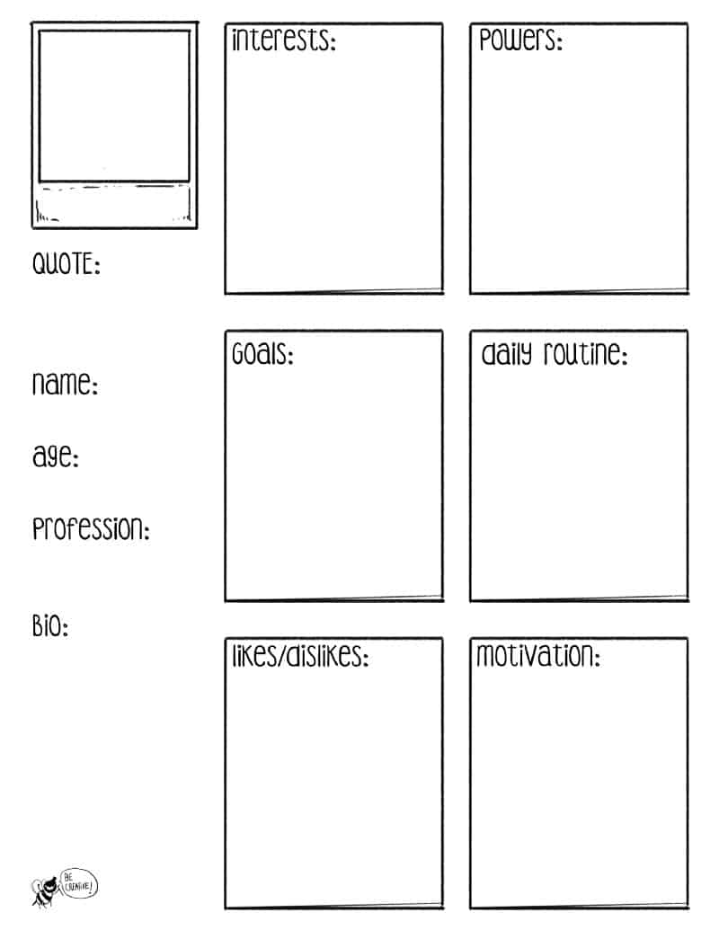
An exercise in design thinking
2. Empathize
Empathy is a critical starting point for any design thinking endeavor. It means making design and business decisions from the perspective of the end-user or customer and truly understanding and anticipating their needs. These design thinking exercises help you get into the minds of your users, identify patterns and challenges, and relate these to the problem your team needs to solve.
Personas
Creating personas is an effective way to focus on your user and ensure that you are designing for their top needs. Personas are a representation of your target user — their typical characteristics, challenges, and desires. On average, you create one to three personas for your project so that you can focus on different needs and inspire divergent ways of looking at a problem.

Slide 11
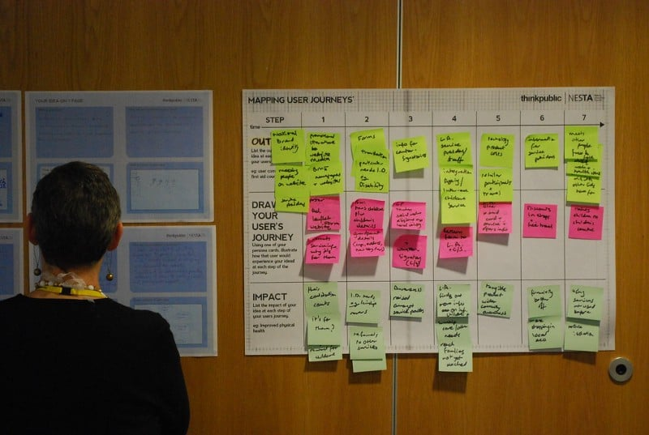
An exercise in design thinking
User Journey Mapping
User or customer journey mapping is another critical exercise when you are trying to build empathy for the user and uncover new ways to answer their top needs. Start by identifying all of the moments that a user goes through from start to finish when interacting with your particular product, service, or experience. These are your moments or milestones along the top of your journey map.
For example, imagine that you are designing a new experience of going through the TSA checkpoint at the airport. Your moments along the top of this user journey map might be: Pack for Trip — Travel to Airport — Arrive at Airport — Find Security Line — Show ID to TSA — Go through Security — Find Gate — Arrive at Destination.
Once you have your top-level journey moments or touchpoints, use your personas (see above) to go step-by-step and capture what your user is feeling, thinking, and doing at every phase. Through this process, you can begin to map the breadth of problems your user faces to identify the most prominent issues to tackle through design or innovation.

Slide 12
An exercise in design thinking
3. Ideation
Ideation is the phase of your project when you need to generate many different possible solutions or answers to your user’s problems or challenges. You don’t want to come up with one idea and put all your energy and focus into that. The goal of ideation is to go wide, come up with tons of ideas (even crazy ones) so that you have a lot to work with when it is time to focus on some ideas to prototype and test. When you need to get the creativity flowing, these design thinking exercises will unleash your thought process.
SCAMPER
SCAMPER is a method of focused brainstorming. But, rather than just saying “Come up with ideas!”, the SCAMPER acronym runs you through seven techniques for idea generation: Substitute, Combine, Adapt, Modify, Put to another use, Eliminate and Reverse.

Slide 13
An exercise in design thinking
You use SCAMPER like this: first, identify the product or service you’re working with or the business question at hand. Run through the SCAMPER list and ask yourself questions based on the letters. (You can feel free to jump around and focus on the ones that are inspiring you the most.)
For example, let’s say you work at Uber. You need to think of ways to innovate. You take Combine and think: How could I combine Uber with another experience that riders need? You say to yourself: Riders need food when they are coming home in an Uber late at night. This might lead you to think of an experience where Uber riders can order pizza and a car at the same time. Their driver arrives with a hot pizza in the car and the rider can eat it on the way home. (Ok, this example might just describe UberEats, but you get the idea.)

Slide 14
An exercise in design thinking
Crazy 8s
Crazy 8s is an activity that we run as part of every Design Sprint, but it can be used anytime you want to come up with a bunch of ideas quickly. The simplicity of this one is wonderful:
Grab a piece of paper and fold it into eight sections
Set a timer for 8 minutes
Have participants sketch a distinct idea in each section. (Remind them that the ideas don’t have to be amazing, or even viable. The point is getting ideas down on paper and not censoring themselves.)

Slide 15
An exercise in design thinking
4. Decisions
It can be easy and fun to come up with new ideas and solutions. But, making decisions? Not always as fun or straightforward. Thankfully, design thinking provides us with some great methods to help filter information. Try these design thinking exercises to help you make creative and impactful decisions.
Affinity Grouping
Affinity grouping is a way to bubble up big themes in a large group of ideas. Assess all of the ideas you’ve generated as a group. Hopefully, you’re working with Post-its, and you can start to move or cluster like ideas together. Create a name or theme for each group of ideas. Once you have a set of big ideas, you can vote as a group about what is most important to focus on.

Slide 16
An exercise in design thinking
Dot Voting
Dot voting is another way you can get a sense of what ideas are resonating as most important with the group. Give everyone in the group 3–5 (or more!) sticky dots. At the same time, have everyone put their dots on the idea or concept that they like the most. In the end, you have a heat map of the ideas that the group gravitates toward.
Note and Vote
Note and Vote is another method that comes out of the Design Sprint. The benefit of this exercise is that it gives everyone an equal vote or voice in decision-making. It’s super simple but effective.
Let’s say you have a series of ideas that you are reviewing as a group. Have everyone silently write down which idea is their favorite on a Post-it note. Once they’re done, have everyone put their vote up on the wall or whiteboard at the same time. Review the votes, see what idea has the most votes, and have a conversation around the pros and cons of the 1–3 “winners.”

Slide 17
Implementing design thinking for better process
Design thinking is a human-centered approach to problem-solving that can be used to improve business processes in a variety of industries. By understanding the needs of users and iterating on solutions, businesses can create products and services that are both effective and user-friendly.
Benefits of implementing design thinking in business processes:
Increased customer satisfaction: By understanding the needs of users, businesses can create products and services that are more likely to meet their needs.
Reduced costs: Design thinking can help businesses to identify and eliminate waste in their processes.
Increased innovation: Design thinking can help businesses to come up with new and innovative ideas.
Improved employee morale: Design thinking can help employees to feel more engaged and creative in their work.

Slide 18
Implementing design thinking for better process
Steps for implementing design thinking in business processes:
Empathize: The first step is to understand the needs of users. This can be done through research, such as surveys, interviews, and observation.
Define: Once you have a good understanding of the needs of users, you can define the problem that you are trying to solve.
Ideate: The next step is to generate ideas for solutions. This can be done through brainstorming, sketching, and prototyping.
Prototype: Once you have a few ideas, you can create prototypes to test them out. Prototypes can be anything from a simple sketch to a working model.
Test: The final step is to test your prototypes with users. This will help you to identify any problems and make improvements.

Slide 19
Implementing design thinking for better process
Tips for implementing design thinking in business processes:
Get buy-in from leadership: It is important to get buy-in from leadership before implementing design thinking. This will help to ensure that you have the resources and support you need to be successful.
Create a culture of innovation: Design thinking is most effective when it is embedded in the culture of the organization. This means creating an environment where employees feel comfortable taking risks and experimenting with new ideas.
Use the right tools and resources: There are a number of tools and resources available to help you implement design thinking. These include books, articles, online courses, and software.
Get help from experts: If you are new to design thinking, it may be helpful to get help from experts. There are a number of consultants and firms that can help you to implement design thinking in your organization.

Slide 20
Implementing design thinking for better process
Actionable design thinking steps
You can implement design thinking and bring its benefits to your organization in four key ways:
1. Focus on the problem
Companies often fail at effectively solving problems or meeting goals because they don’t correctly identify the user or problem initially. To identify your problem, you can:
Listen. Put yourself in users’ shoes and think through their lenses.
Ask questions. Who encounters the problem and why? Why did past attempts to solve it fail?
Have collaborative conversations. Working in silos is a trap. Engage with everyone, not just your team.
Stay unbiased. Don’t assume you immediately understand the problem or solution. By being open-minded you might find something you weren’t expecting.

Slide 21
Implementing design thinking for better process
2. Develop design thinking skills on your team
Traditionally, project managers or engineers handled the ideation phase of the design thinking process. But it’s not limited to those functions. Everyone can and should participate by asking questions, understanding and testing. To develop your team’s design thinking skills, you can:
Practice the mindset. Start implementing the process in your role whenever you can. For example, if you oversee onboarding, think about ways you can test a new approach or understand the new employee mentality by gathering feedback through a survey. Remain open to new outcomes.
Foster interest. If you have team members who want to take initiative and expand their skill sets, make sure to nurture that — by encouraging experimentation or perhaps reimbursing costs for design thinking classes.

Slide 22
Implementing design thinking for better process
3. Have (or start having) more debriefs
This is a continuous process. It’s a process of iterating on previous experiments so the product or outcome can improve. However, learnings can’t be implemented if there’s no feedback. To create a learning culture through gathering feedback, you can:
Be open about what went wrong. Set an example by demonstrating failure is an expected part of design thinking. Openly discuss which tests failed and why.
View failure as learning. Trying and failing a new approach serves the crucial function of narrowing the list of possible processes. This gets you and your team closer to the best approach. Encourage failure.

Slide 23
Implementing design thinking for better process
4. Embrace the feedback loop
The goal of design thinking isn’t perfection but finding the best answer possible. And the best answer likely won’t be the first answer. A constant feedback loop is essential. To implement a feedback loop, you can:
Test and iterate as much as possible. Find new ways and angles to try out your assumptions. You might come across something you would’ve never thought of otherwise.
Have feedback sessions often. When you embrace feedback, it creates a safe space to innovate and prevents the same mistakes from happening again.

Slide 24
Implement design thinking process in various Industries
Design thinking in business is a mindset for solving problems creatively. It allows you to design solutions for end users and also emphasizes implementation. While design thinking is an ideology based on novelty and usefulness, it is anchored around a human-centered approach. It is also a linear method that seeks to solve complex problems. This approach shifts the focus from the business engineering outlook. It means that there is no point in innovating something if people won’t use it.
Design thinking in business results in solutions that are:
Technically feasible so that purposeful products and processes can be developed.
Economically viable for implementation.
Desirability to meet a human need.

Slide 25
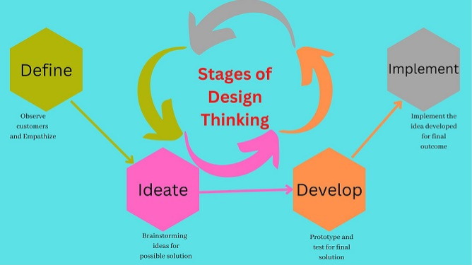
Implement design thinking process in various Industries
Stages of Design Thinking in Business
Design thinking is a human-centric, solution-based approach to solving problems. With reverse and repeat, the phases progress from concrete to abstract thinking. Abstract thinking increases the likelihood of an idea being unique. But still, it is critical to anchor abstract ideas into concrete thinking for a valid solution. The following four steps describe effective innovation and design thinking:

Slide 26
Implement design thinking process in various Industries
Define: In this stage, you observe consumers without bias. To gain a deeper understanding as a designer, you lean towards user-centric elements and emphasize problematic areas. You can now narrow down the focus of the design thinking process. Eventually, identify the problem and come up with the most appropriate solution.
Ideate: The next step is to brainstorm potential solutions. The goal is to let your creativity run wild and overcome cognitive fixedness. Hence, devising new and innovative ideas that solves the identified problems. At the end of this process, you generate a bunch of different ideas and move forward with a few of them.
Develop: The third phase turns ideas into actual solutions. It involves many rounds of prototyping, testing, and experimenting to answer critical questions. This step isn’t about perfection. In fact, based on the results you should prepare yourself to go back to the ideation or defining stages.
Implement: In the fourth and final phase, implement the solution you have developed. Until you find a successful solution, you’ll likely have to refer back to a prior phase. And you iterate and repeat until you reach a final solution. Similarly, learning from experience is part of the innovation and design thinking process. As design thinking is often linear, it is recommended to have such an approach.

Slide 27
Implement design thinking process in various Industries
Scope of Design Thinking in Industries
The proliferation of design thinking in industries aims to break complex issues. Analyze and then solve them into tangible ones. It is a collaborative venture, mastered through practice with peers. There is a scarcity of experienced professionals in this industry. That is the reason design thinking jobs pay well.
The occupations that demand high design thinking skills:
Marketing managers
Industrial engineers
Software developers
Operations managers
Technical Analysts
Design engineers
Computer and information systems managers
Lead Innovation
Strategist, Brand Experience Design
Design Researcher
Head Product Design
Scope of Design Thinking in Industries
A few of the expected tasks across different roles include:
Networking with clients and clarifying their challenges.
Investigating to get access to information.
Applying hands-on methods to find ideas and solutions.
Structuring business plans, service design, etc.
Implementing products in the market after testing them.
Re-inventing existing products to create scalable solutions.

Slide 28
Implement design thinking process in various Industries
Examples of Design Thinking
Design thinking is a powerful tool to approach difficult business problems. You can apply it to both big and small problems. Real-world examples are an effective way to leverage design thinking. However, it is beneficial to learn how big brands and companies approach problems. Also delivers what users and customers expect from them.
While these examples prove the success that design thinking can yield. You can therefore learn and practice it before implementing them into your business model.
1. Netflix
Netflix, an industry giant is a prime example of design thinking . Not only it came up with the idea to stream movies to customers’ homes through the internet. But also eliminated the inconvenience of delivering DVDs to customers’ homes on a subscription model. Accordingly, they kept using design thinking to come up with new ideas. They also responded to the need for original content that wasn’t airing on other networks. It took design thinking a step further after adding short trailers to its interface. Hence improving their user experience.

Slide 29
Implement design thinking process in various Industries
2. Uber
With the help of design thinking, Uber introduced cashless payments. Eventually, reducing fraudulent transactions. It also provided the power to give ratings to both drivers and users. Therefore increasing their incentives for good behavior. Above all, it eliminated problems that had been plaguing customers in the past.
3. Uber Eats
Food delivery apps have changed the way we eat. Each restaurant has its own specialty and Uber Eats connects people to these places in cities. Design thinking helped shadow delivery drivers from restaurant to customer. Thus, ensuring a smooth delivery process. Although, transforming the customer experience of food delivery added to its success, constant evolution was the key.
4. Oral B
Oral B upgraded its electric toothbrush using design thinking. Not only did the company find effective solutions. But also prototyped before implementation. While users expected the toothbrush to charge conveniently during travel. At the same time, ordering replacement heads should be easy to handle. Also, the toothbrushes should connect to phones and send notifications on time as alerts. The focus was on what users wanted rather than what the company wanted to sell.

Slide 30
Implement design thinking process in various Industries
5. Apple
Apple has some exceptional design-thinking products like iPad, iPhone, Apple Watch, and MacBook. The initial product had an operating system that could accommodate future requirements. Accordingly, the products could be developed keeping customers’ needs at the edge. An intuitive user experience has always been an integral part of Apple’s products. For instance, facial expressions, the music experience, the interface, and more gives impeccable user experience. Apple puts a premium on design thinking in all its products. Focuses on what consumer needs and develops products based on those needs. Create prototypes, and then test them to see that the product is not limited by technology.
6. GE Healthcare
Diagnostic imaging revolutionized the healthcare industry. Still, there was an unidentified problem in the pediatric ward. GE Healthcare saw how little patients cry during long procedures. Considering this, GE Healthcare used design thinking to redesign MRI machines for children. For example, the “Pirate Adventure” yielded unexpected success. Clearly, transformed MRI machines from dark black holes to pirate ships. It had the scenery of beaches, sandcastles, and the ocean to convert cries into smiles.

Slide 31
Implement design thinking process in various Industries
7. IBM
The company has gone through many stages in its development. IBM used design thinking to create a cloud platform for application development. The main aim was to help developers establish cloud applications much faster. Understanding the prospective customers allowed IBM to create an easy-to-use functional platform. It helped reduce the cost and time spent by developers setting up infrastructure.
Takeaways from the Design Thinking process:
Consider the wider picture: Each company should think about the customer’s perspective. Also, recognize when to use empathy.
Find alternative solutions to the problem: Recognize the problem businesses face. Think of alternative solutions to practice both empathy and ideation.
Analyze competitors’ strategies: Investigate each company’s competitors to learn about their similar problems. Find similar solutions, compete, and follow a four-step design thinking process.

Slide 32
Design thinking for Startups
The practical steps for integrating design thinking into startup culture and workflows.
1. Mindset Shift
Initiate a culture change that values experimentation and iteration, encouraging team members to embrace failure as part of the learning process. Integrate resources like design thinking podcasts into your company’s learning programs to provide accessible insights and real-world examples, empowering team members to adopt a mindset of continuous improvement and experimentation.
2. Collaborative Environment
Establish an environment where open communication and collaboration are encouraged, breaking down bureaucratic barriers between teams and departments.

Slide 33
Design thinking for Startups
3. User Research
Prioritize user research to understand customer needs and pain points, utilizing techniques such as interviews, surveys, opt-in forms, and traffic analysis to gather insights.
4. Design Thinking Tools
Equip teams with design thinking tools for mind mapping and collaborative creation, such as Miro, Hotjar, and Stormboard. These tools will allow them to generate creative solutions and visualize existing concepts.
5. Continuous Testing and Refinement
Implement a feedback loop where solutions are tested by customers and refined by the team based on feedback, ensuring that products and services meet customer needs effectively.
These steps allow startups to embed design thinking principles into their culture and workflows, creating innovative products and solutions that resonate with customers.

Slide 34
Design thinking for Startups
6. Team Dynamics
Creating a collaborative environment for implementing design thinking entails promoting open communication, trust, and psychological safety within teams. Every startup founder can implement design thinking by encouraging active listening, respecting diverse viewpoints, and ensuring that all team members feel equally valued and that each contribution matters.
Establishing clear goals and objectives for collaborative efforts provides direction, while structured brainstorming sessions and co-creation activities facilitate effective collaboration.
Embracing a culture of experimentation and risk-taking encourages innovation and problem-solving, where failure is viewed as a natural part of the learning process.
These strategies help create an environment where teams can leverage their expertise and creativity to drive innovation.

Slide 35
Design thinking for Startups
Broad Applications of Design Thinking in Startups
Implementing design thinking principles is crucial for driving innovation and achieving success.
Embracing a human-centered approach, startups can revolutionize product development, enhance customer experiences, and strategically navigate challenges to stand out in the market.
Product Development
Design thinking can significantly enhance product development processes by applying a human-centered approach.
Design thinkers immerse themselves in understanding users' needs and pain points, iterating through prototypes and gathering feedback to create products and solutions that truly address the customer's problem.
A startup design agency looking to develop a new product app may embrace design thinking principles by conducting user research to identify specific challenges faced by potential customers.
Design thinking prioritizes the user and enables companies to develop innovative, user-friendly products that fulfill their customers' needs. Also, it promotes a culture of generating new ideas and experimenting with new tools within teams, leading to more effective and collaborative work.

Slide 36
Design thinking for Startups
Customer Experience
Implementing design thinking principles can profoundly impact understanding and improving customer experience. Empathizing with users and gaining insights into their behaviors and preferences, startups can create meaningful solutions that address customers' problems more effectively.
For example, a startup in the e-commerce sector may utilize design thinking to identify pain points in the customers’ online shopping journey, such as confusing navigation or lack of personalized recommendations.
Through iterative design and testing solutions based on user feedback, the startup can enhance the overall customer experience, resulting in higher customer satisfaction and loyalty.

Slide 37
Design thinking for Startups
Business Strategy
Design thinking is crucial in strategic planning and decision-making within startups, fostering a culture of innovation and creative problem-solving.
Applying design thinking principles throughout the process allows startups to generate innovative ideas and develop unique solutions to address complex business challenges.
For instance, a startup facing stiff competition in the market may apply design thinking to identify untapped opportunities, such as new niches, and differentiate itself through innovative solutions.
Continually iterating on strategies based on user feedback and market insights, startups can adapt and thrive in the dynamic startup ecosystem, increasing their chances of success amidst uncertainty.

Slide 38
Design thinking for Startups
Design Thinking in Action
Now that we’ve studied various aspects of design thinking let’s look at design thinking in action based on the examples of three world-known brands.
Airbnb
Airbnb, a startup that revolutionized the hospitality industry, applied design thinking to create a user-centric platform. After conducting surveys of hosts and guests, they identified pain points such as trust issues and lack of personal connection.
Through iterative design processes, they developed customer-centric solutions by introducing user reviews, verified profiles, and personalized recommendations. This human-centered approach not only improved the customer experience but also increased trust and enabled the platform to expand its global reach.

Slide 39
Design thinking for Startups
Slack
Slack, a team business communication platform, exemplifies how design thinking can drive product development.
Understanding the complexities of workplace communication, Slack's designers immersed themselves in user research to identify challenges various teams face.
They developed the problem statement through prototyping and testing and refined the tool’s features like channels, integrations, and customizable notifications for seamless and efficient communication.
This problem-solving approach prioritized user needs and feedback, making Slack a staple in modern workplaces.

Slide 40
Design thinking for Startups
Headspace
Headspace, a meditation and mindfulness app, effectively applied design thinking to create a user-centric platform.
Understanding the complexities and challenges individuals face in maintaining a regular meditation practice, Headspace focused on simplifying the process and making it accessible to people unfamiliar with mindfulness practices.
After conducting customer surveys and studying their competitors, they developed features like guided meditation sessions, personalized recommendations, and progress tracking.
Plus, Headspace meticulously crafted every aspect of its app design, ensuring that every color, shape, and line served a deliberate purpose. The app's designers deliberately crafted characters to enhance concentration among users. These characters exhibit a variety of shapes, sizes, and color combinations to achieve this goal.
Notably, the design team consciously avoided sharp edges, opting for curved and free-flowing elements instead. This meticulous attention to detail culminated in a warmer and friendlier design, creating a more friendly space for users.
This approach not only enhanced the user experience but also helped individuals achieve their wellness goals, such as stress relief and better sleep within a shorter time frame,
As a result, Headspace quickly became a prominent player in the wellness industry.

Slide 41
END of UNIT IV

